Slide 1
What Happens to Proprietary Post-Secondary Education If Biden Wins?
Webinar October 23, 2020

Slide 2
Hosted By
Greg Gragg
CEO, Gragg Advertising
Darryl Mattox
COO/President, Gragg Advertising

Slide 3
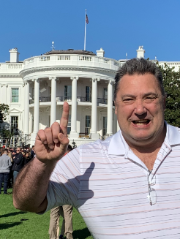
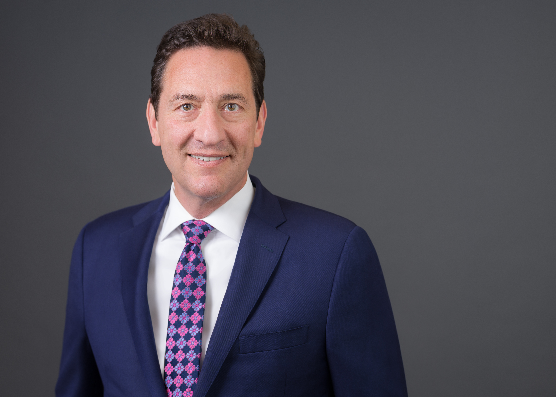
Guests
Tom Netting
CEO, Ten Government Strategies
Daniel Elkins
ED, Veterans Education Project
Tony Guida
Partner, Duane Morris

Slide 4
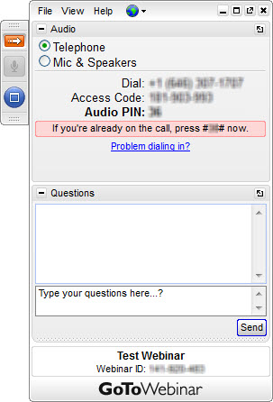
Housekeeping
Attendees are in listen only mode.
Dial in via phone or mic & speakers
Minimize control panel using orange arrow
Join the conversation!
Submit your questions in GoToWebinar control panel
Tweet us @GoWithGragg and use #GraggChat
Questions?
Submit your questions via the GoToWebinar control panel.
Don’t see the question box? Use the orange grab tab arrow to expand
Need a certification from today’s webinar?
Please email: webinars@graggadv.com

Slide 5
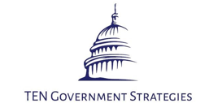
Tom Netting
Tom Netting advocates before Congress, federal agencies, and state governments on behalf of entities seeking to inform and influence the legislative and regulatory process.
With more than 30 years of experience working in government relations and public policy, Tom has established himself as a leader in strategic policy development and advocacy in the fields of higher education and workforce development, elementary and secondary education, healthcare, veterans affairs, and the procurement of federal appropriations.
Prior to the formulation of TEN Government Strategies, LLC, Tom held positions as:
Public Policy Advisor/Lobbyist within two Washington, D.C.-based government relations firms
Director of Government Relations for multiple national higher education associations
Legislative and Regulatory Strategist/Advocate for a myriad of elementary and secondary, post-secondary, and career and technical education organizations.

Slide 6
Daniel Elkins
Daniel Elkins is the founder and Executive Director of the Veterans Education Project (VEP). His duties include engaging with Congress, the White House, and other key stakeholders in the Administration on behalf of Student Veterans. As the Executive Director, his is day-to-day responsibilities included developing new relationships with key stakeholders on Capitol Hill and partnering with institutions of higher education.
Daniel is an expert witness to Congressional and federal offices. He maintains strong relationships with the White House, other Veteran Service Organizations, Congress, and the Departments of Defense, Education, Labor, and Veterans Affairs, which often places him at the forefront of policy decisions that impact Student Veterans. He is also a Green Beret and proud combat veteran.

Slide 7
Tony Guida
Tony is a partner and a co-lead of the Education Industry Practice Group of Duane Morris LLP, an Am Law 100 firm with more than 800 lawyers and 30 offices throughout the United States and internationally. He is also on the firm’s Partner’s Board. Tony is one of a handful of attorneys nationwide that focus exclusively on the laws and regulations relating to the education sector (PreK-12, postsecondary, EdTech and corporate training), spending most of his time on mergers and acquisitions, government response and crisis management, and federal and state education policy. Prior to joining Duane Morris six years ago, Tony spent more than 15 years in the higher education industry in senior executive positions.

Slide 9
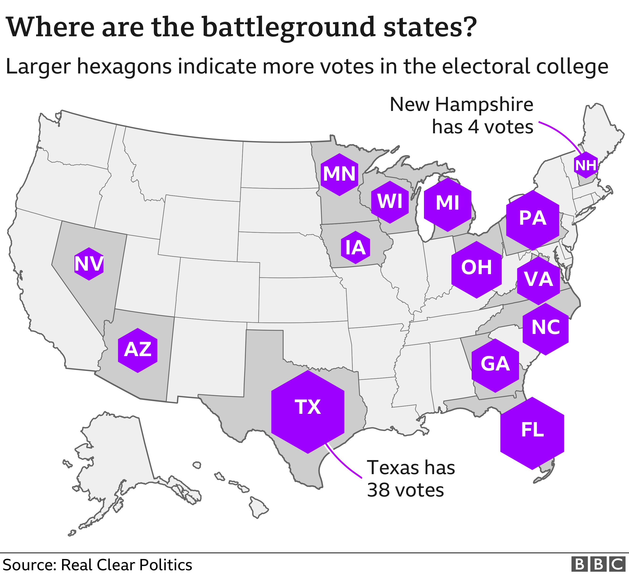
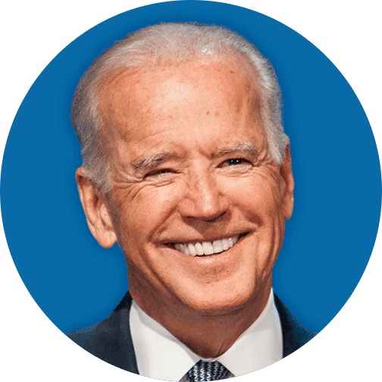
Presidential Polling
On September 27th, Biden’s lead in national polling 50% to 43%
As of October 19th, Biden’s lead in
National polling is now 53% to 42%

Slide 10
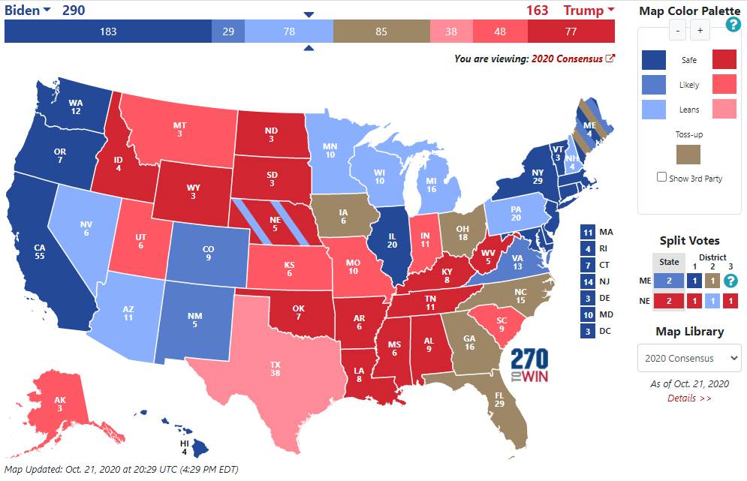
Presidential Polling

Slide 11
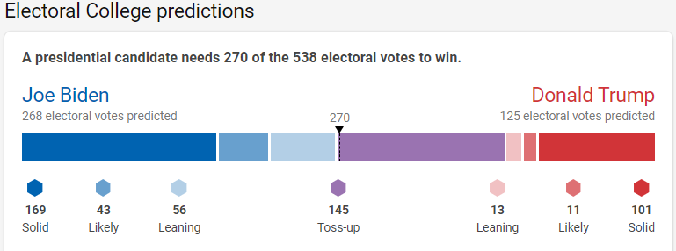
Presidential Polling

Slide 12
U.S. Senate Polling
Safe Dem
DE: Coons (D) IL: Durbin (D) MA: Markey (D) MN: Smith (D) NH: Shaheen (D) NJ: Booker (D) NM: Open OR: Merkley (D)
RI: Reed (D) VA: Warner (D)
Leans Dem
CO: Gardner (R)
AZ: McSally (R)
MI: Peters (D)
Toss Up
GA1: Perdue (R)
GA2: Loeffler (R)
IA: Ernst (R)
ME: Collins (R)
MT: Daines (R)
NC: Tillis (R)
SC: Graham (R)
Leans GOP
AL: Jones (D) AK: Sullivan (R) KS: Open KY: McConnell (R)
TX: Cornyn (R)
Safe GOP
AR: Cotton (R)
ID: Risch (R)
LA: Cassidy (R)
MS: Hyde-Smith (R)
NE: Sasse (R) OK: Inhofe (R) SD: Rounds (R)
TN: Open (R) WV: Moore Capito (R)
WY: Open (R)

Slide 13
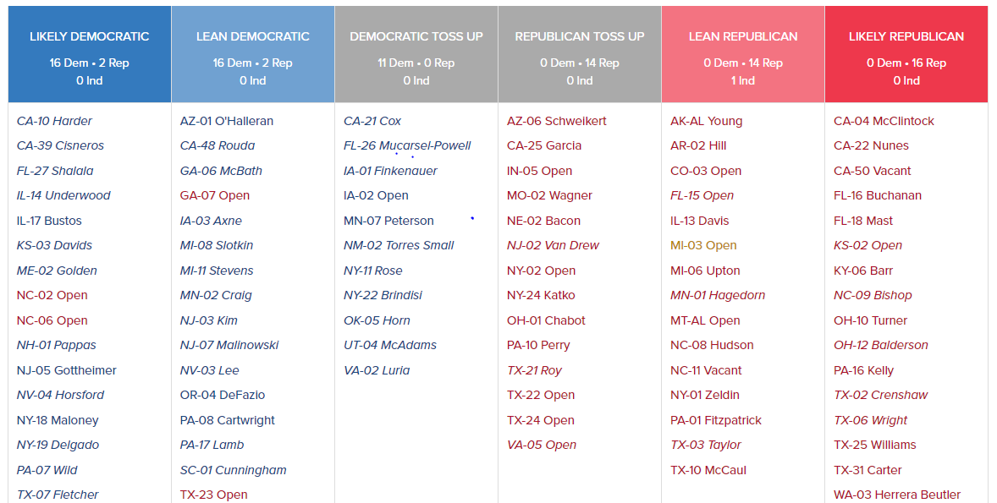
U.S. House of Representatives Polling

Slide 14
Potential Presidential/Congressional Combinations
Trump remains in office and the Senate remains Republican and the House Democrat
Trump remains in office and the Senate and House are both Democrat
Trump remains in office and the Senate and House are both Republican
Biden is elected as President and the Senate remains Republican and the House Democrat
Biden is elected as President and the Senate and House are both Democrat
Biden is elected as President and the Senate and House are both Republican

Slide 15
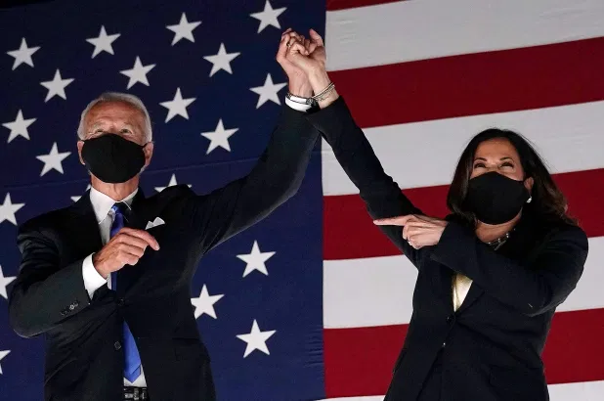

Slide 16
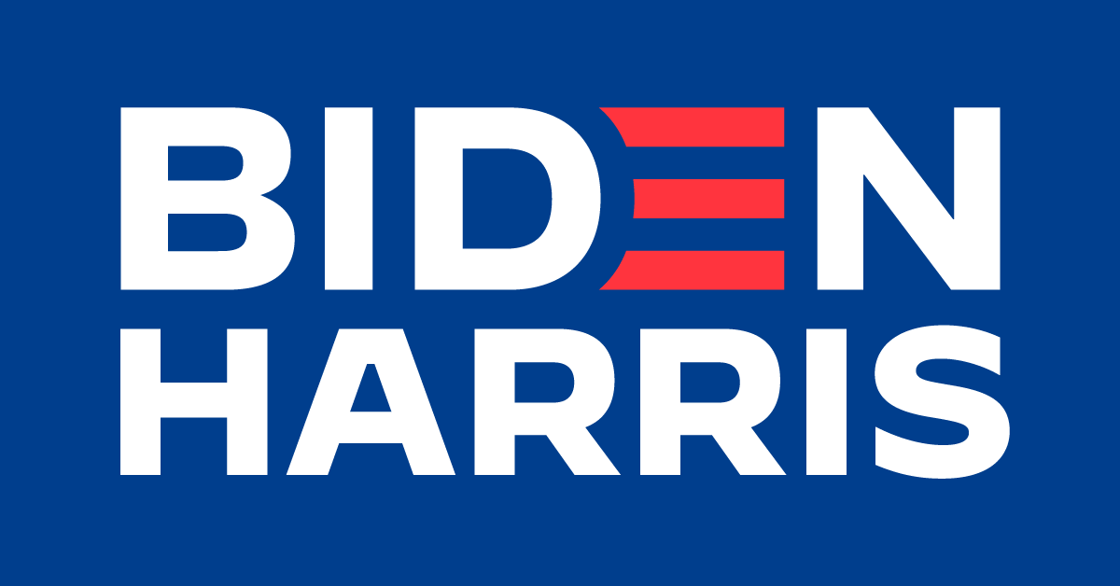
Overview of Education Platform
Biden is proposing a bold plan for education and training post-high school that will give hard-working Americans the chance to join or maintain their place in the middle class, regardless of their parents’ income or the color of their skin.
Invest in community colleges and training to improve student success and grow a stronger, more prosperous, and more inclusive middle class.
Strengthen college as the reliable pathway to the middle class, not an investment that provides limited returns and leaves graduates with mountains of debt they can’t afford.
Support colleges and universities that play unique and vital roles in their communities, including Historically Black Colleges and Universities and Minority-Serving Institutions.

Slide 17
Access/Affordability
Provide two years of community college or other high-quality training program without debt for any hard-working individual looking to learn and improve their skills to keep up with the changing nature of work.
Create a new grant program to assist community colleges in improving their students’ success.
Tackle the barriers that prevent students from completing their community college degree or training credential.
Invest $8 billion to help community colleges improve the health and safety of their facilities and equip their schools with new technology.
Invest $50 billion in workforce training, including community-college business partnerships and apprenticeships.

Slide 18
Access/Affordability Cont’d
Double the maximum Federal Pell Grant award for low-income students.
Make public 4-year colleges and universities tuition-free for all families with incomes below $125,000 a year (adopts Sen. Sanders’s College for All proposal).
Direct funds to public and nonprofit colleges and universities and minority-serving institutions based on proportion of low-income students those institutions enroll and graduate.
Establish new federal grant program to help community colleges create emergency grant programs for students who experience unexpected financial challenge that threatens their ability to stay enrolled.
Restore formerly incarcerated individuals’ eligibility for Federal Pell Grant.

Slide 19
Student Debt/Loan Cancellation
Cancel student loans through executive action for students who went to “predatory schools” where a determination of misrepresentation or fraud is made by USDE, State Attorneys General or the courts.
Authorize up to $10,000 in student debt relief per borrower for COVID-19 relief.
Improve Public Service Loan Forgiveness program, including forgiving up to $10,000 in student debt per year for up to five years.
Allow individuals holding private loans to discharge them in bankruptcy.
Change the tax code so that debt forgiven through the income-based repayment plan will not be taxed.

Slide 20
Student Debt/Loan Cancellation Cont’d
Loan forgiveness for undergraduate tuition-related federal student debt from public colleges and universities for debt-holders earning up to $125,000 a year, with appropriate phase-outs.
Loan forgiveness for Public Servants or Teachers (PSLF/TLFP) and borrowers with a total or permanent disability.
Pause monthly billing interest on federal student loans for people earning less than $25,000, cap payments at 5% of discretionary income for those earning more than $25,000 and forgive remainder after 20 years.

Slide 21
For-Profit Colleges
Stop for-profit education programs from profiteering off of students.
The Biden Administration will require for-profits to first prove their value to the U.S. Department of Education before gaining eligibility for federal aid.
Return to the “Obama-Biden” Borrower Defense to Repayment Rule, forgiving the debt held by individuals who were deceived by the worst for-profit college or career profiteers.
Enact legislation eliminating the so-called 90/10 loophole that gives for-profit schools an incentive to enroll veterans and servicemembers.
Strengthen the GI Bill Comparison Tool and School Feedback Tool to put an end to postsecondary institutions’ predatory practices.

Slide 22
Regulatory Priorities
Redefine and Extend the 90/10 Rule Requirements
Reinstitute the Gainful Employment Rule
Return to the “Obama-Biden Borrower’s Defense Rule”
Return to the “Obama-Biden Title IX Protections”
Revise the Accreditation Requirements with Emphasis on NACIQI Oversight Rules
Revisit the Incentive Comp Regulations and Extend Their Reach to Include All Third-party Servicers
Revise and Extend Limits on Schools Ability to Transition from For-profit to Non-profit Status
Reestablish and Enhance “Obama-Biden Loan Repayment Rate” Requirements

Slide 24
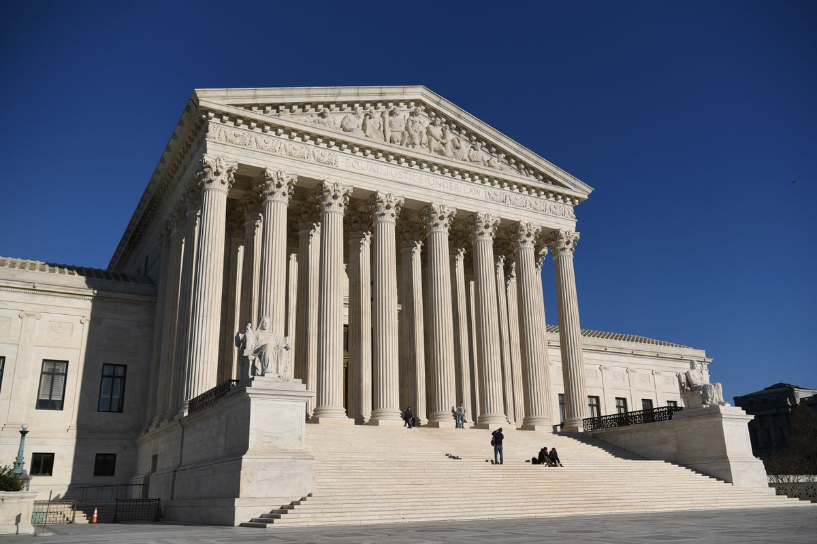
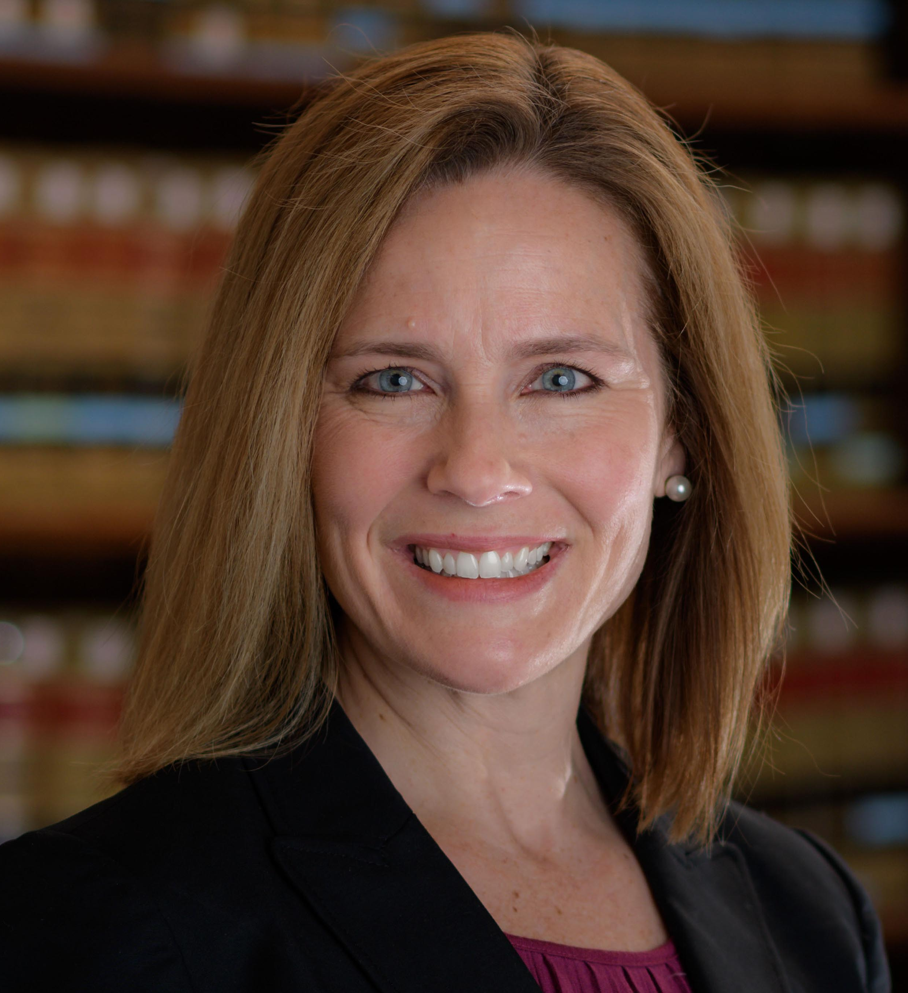
SCOTUS Vacancy Fight
Amy Vivian Coney Barrett is an American lawyer, jurist, and academic who serves as a circuit judge on the U.S. Court of Appeals for the Seventh Circuit. President Donald Trump nominated Barrett to the Seventh Circuit Court of Appeals on May 8, 2017, and the Senate confirmed her on October 31, 2017.

Slide 25
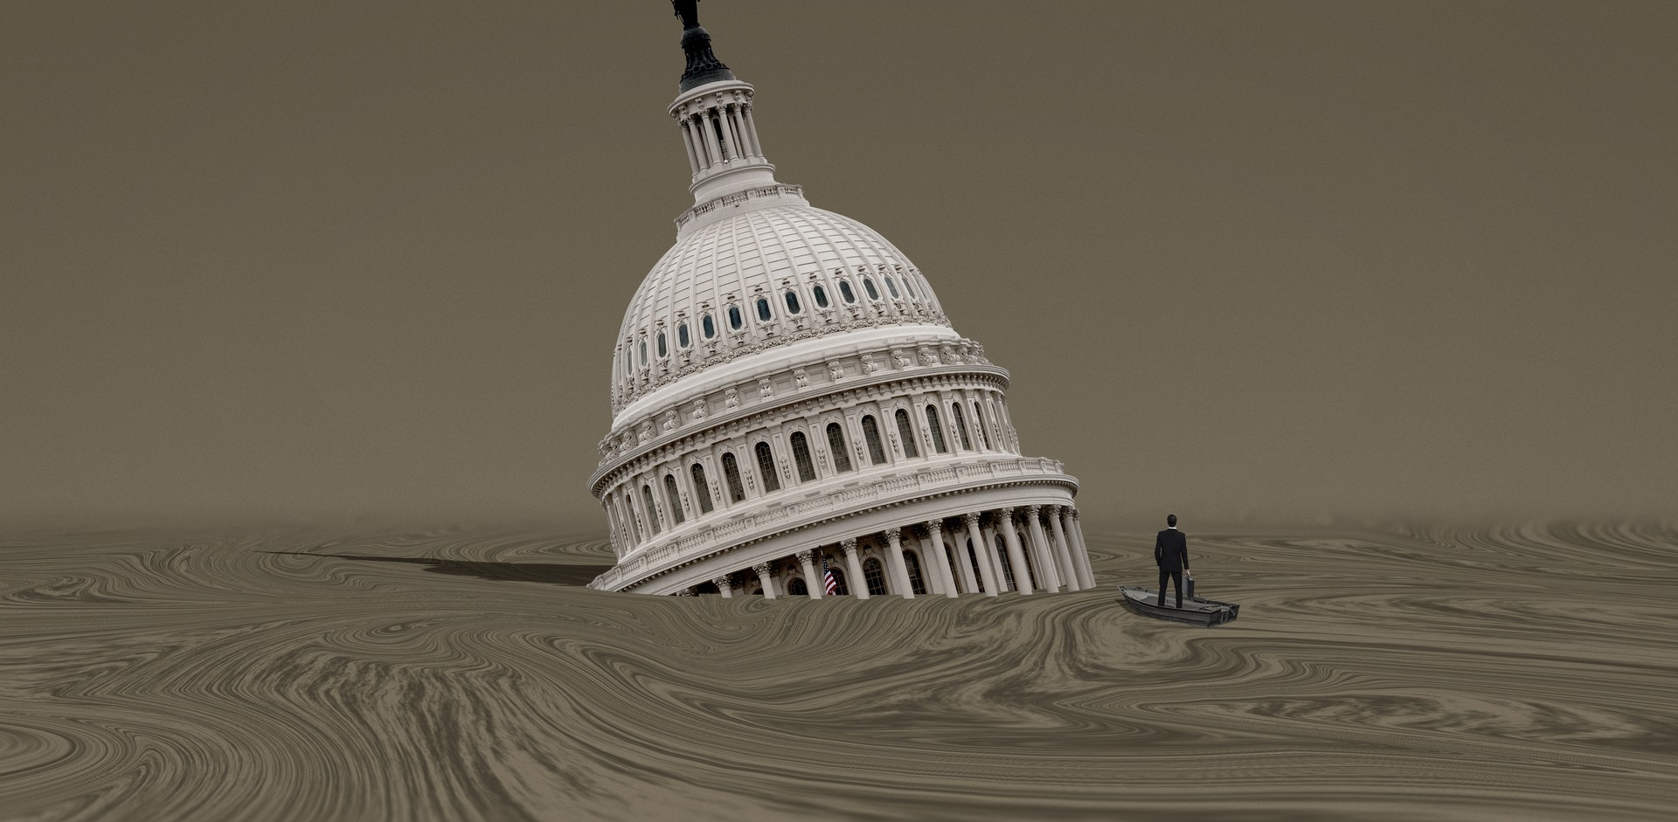
Unfinished Business
Before the 116th Congress adjourns they still have a tremendous amount of work to get done.
The questions is, after the highly contentious vote on Supreme Court Justice Cohen’s appointment and the outcome of the election, will they choose to tackle these issues or hold them over for the 117th Congress?
Key Areas To Determine Include:
Additional Emergency Relief/Economic Stimulus Funding
Fiscal Year 2021 Annual Appropriations
Senator Alexander’s “Gold Watch”

Slide 26
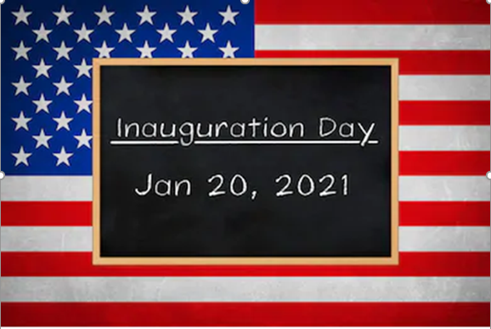

Slide 27
Executive Orders
Reversal of many of President Trump’s Regulatory Reform Executive Orders:
Reducing Regulation and Controlling Regulatory Costs
Enforcing the Regulatory Reform Agenda
Repeal of White House Initiative To Promote Excellence and Innovation at Historically Black Colleges and Universities
Limitations on implementation of Secretary DeVos’ Title IX regulations

Slide 28
How quickly could a Biden Administration unwind current regulatory interpretations and/or implement new interpretations?
Under the Regional Meetings and Negotiated Rulemaking provision of the Higher Education Act (20 U.S. Code § 1098a), all Title IV – Student Assistance regulations promulgated after October 7, 1998 must be subject to Negotiated Rulemaking, “unless the Secretary determines that applying such a requirement with respect to given regulations is impracticable, unnecessary, or contrary to the public interest (within the meaning of section 553(b)(3)(B) of title 5), and publishes the basis for such determination in the Federal Register at the same time as the proposed regulations in question are first published. All published proposed regulations shall conform to agreements resulting from such negotiated rulemaking unless the Secretary reopens the negotiated rulemaking process or provides a written explanation to the participants in that process why the Secretary has decided to depart from such agreements. Such negotiated rulemaking shall be conducted in accordance with the provisions of paragraph (1), and the Secretary shall ensure that a clear and reliable record of agreements reached during the negotiations process is maintained.”

Slide 29
How quickly could a Biden Administration unwind current regulatory interpretations and/or implement new interpretations?
Under the Master Calendar provision of the Higher Education Act (20 U.S. Code § 1089), “any regulatory changes initiated by the Secretary affecting the programs under Title IV – Student Assistance that have not been published in final form by November 1 prior to the start of the award year shall not become effective until the beginning of the second award year after such November 1 date.
Based upon these statutory requirements, it seems that the earliest date that new regulations effecting revisions to the Title IV regulations could take effect following would be July 1, 2022 – unless the new Administration tries to invoke “contrary to the public good” exemption.

Slide 30
Proprietary Oversight 2.0
Reestablishment of the Interagency Task Force Responsible for For-profit Oversight
Reexamination of ACICS Recognition by National Advisory Committee on Institutional Quality and Integrity
Repeal of New Borrower Defense to Repayment Assessment Process and Return to Obama-Biden Era Process
Scrutiny of Use of Higher Education Emergency Relief Funds*

Slide 31
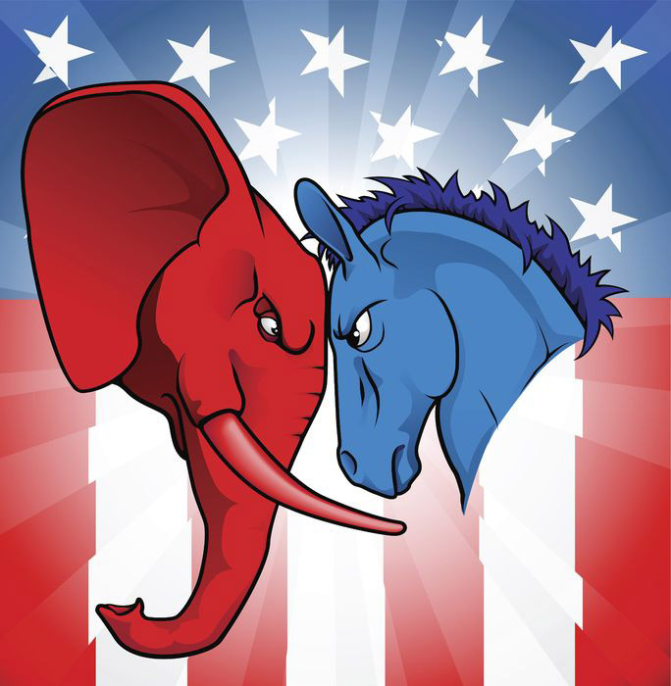

Slide 32
HEA Reauthorization Overview
Democratic House starting point for the 117th Congress is likely to be a modified version of H.R. 4674 – The College Affordability Act (CAA), whose provisions relating to proprietary schools include:
Restoring Obama-era Gainful Employment and BDR rules
Changing the 90/10 rule to 85/15 and closing the so-called “90-10 loophole”
Excluding proprietary schools from Federal Pell Grants for incarcerated individuals and short-term programs
Creating a process for the review and regulation of conversions of institutions from proprietary to nonprofit
Including receiverships in the same category as bankruptcy filings that render institutions forever ineligible for Title IV funding
Creating a secret shopper program to improve enforcement of the ban on incentive compensation and in misrepresentations to students
Creating an FSA Enforcement Unit to review and investigate HEA violations and increase penalties from colleges who make misrepresentations to students

Slide 33
Democratic Legislative Initiatives
Status of for-profit schools:
GE-like Threshold to Participation
90/10
Pell Eligibility Limitations
Free College
Loan Forgiveness
Strict Review and Oversight of Nonprofit Conversions
Hold Owners and Executives of “Predatory Schools and Colleges” Personally Liable for School Misconduct

Slide 34
Higher Education Emergency Relief Fund (HEERF) Enforcement
HEERF oversight will be a key focus in 2021, but will it focus on the use of funds by all IHEs – or solely the predatory proprietary sector?

Slide 35
Restructuring of the Senate HELP Committee
Current Senate HELP Committee
Republicans | Democrats
Chairman, Lamar Alexander (TN) | Ranking Member Patty Murray (WA)
Sen. Michael Enzi (WY) Sen. Richard Burr (NC) Sen. Rand Paul (KY) Sue Collins (ME) Sen. Bill Cassidy (LA) Sen. Pat Roberts (KS) Sen. Lisa Murkowski (AK) Sen. Tim Scott (SC) Sen. Mitt Romney (UT) Sen. Mike Braun (IN) Sen. Kelly Loeffler (GA) | Sen. Bernie Sanders (I-VT) Sen. Robert Casey (PA) Sen. Tammy Baldwin (WI) Sen. Christopher Murphy (CT) Sen. Elizabeth Warren (MA) Sen. Tim Kaine (VA) Sen. Maggie Hassan (NH) Sen. Tina Smith (MN) Sen. Doug Jones (AL) Sen. Jackie Rosen (NV)

Slide 36
Senate HELP Committee
Retirements & Candidates for Reelection
Republicans | Democrats
Chairman | Ranking Member Patty Murray (WA)
Sen. Richard Burr (NC) Sen. Rand Paul (KY) Sen. Sue Collins (ME) Sen. Bill Cassidy (LA) Sen. Lisa Murkowski (AK) Sen. Tim Scott (SC) Sen. Mitt Romney (UT) Sen. Mike Braun (IN) Sen. Kelly Loeffler (GA) +2 Vacancies | Sen. Bernie Sanders (I-VT) Sen. Robert Casey (PA) Sen. Tammy Baldwin (WI) Sen. Christopher Murphy (CT) Sen. Elizabeth Warren (MA) Sen. Tim Kaine (VA) Sen. Maggie Hassan (NH) Sen. Tina Smith (MN) Sen. Doug Jones (AL) Sen. Jackie Rosen (NV)

Slide 38
Who We Are
VEP is the only Veteran Service Organization (VSO) in Washington, D.C. that is sector-agnostic and committed to nonpartisan policy and legislation in higher education.
As Veterans serving Veterans, VEP pushes back against unfair regulation, biased research, and partisan legislation that could harms Students Veteran.
We work in the media, on Capitol Hill, with VA, DOD, ED, the Administration, and leaders in higher education.

Slide 39
Our Values
Fair, Bipartisan Advocacy for All Veterans
Veterans attend colleges and universities across all sectors of higher education.
We protect the interests of these service members, regardless of what institution they choose.
Accountability at all institutions without a political agenda.

Slide 40
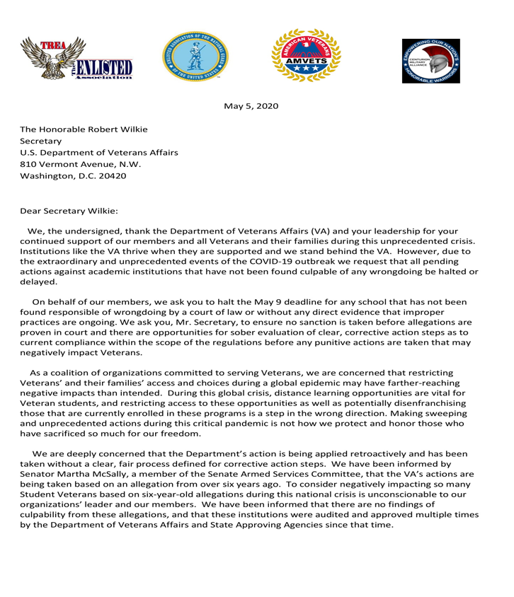
What We Do
Coalition Building
ROA
TREA
AMVETS
NGAUS
Centurion Military Alliance
VEP builds coalitions by winning the hearts and minds within the VSO community.

Slide 41
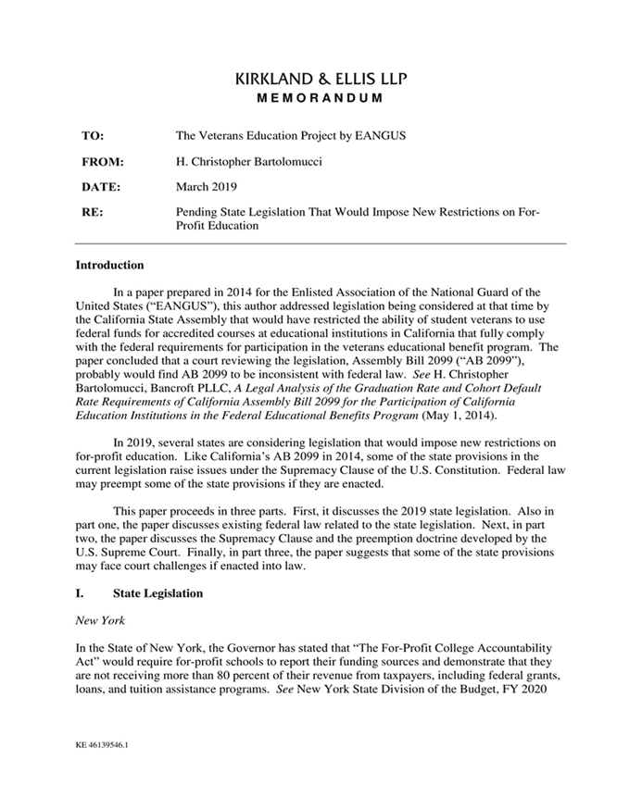
What We Do
State Level 90/10 Engagement
California
New York
Oregon
VEP effectively fights biased policy at the state level.

Slide 42
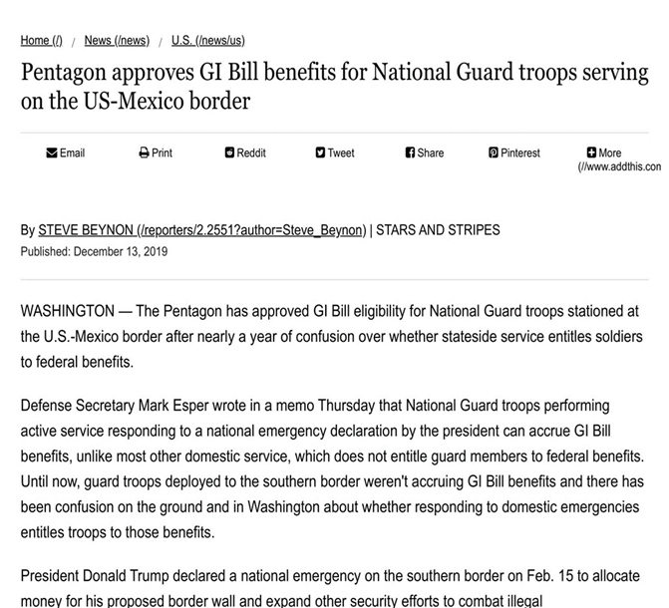
What We Do
Non-partisan Advocacy
GI Bill Eligibility
The Bill Calculator
Holistic Assessments
Suicide Prevention
COVID-19 Guaranteed Benefits Act
VEP fights for nonpartisan advocacy, maintaining its role as an authentic and effective VSO.

Slide 43
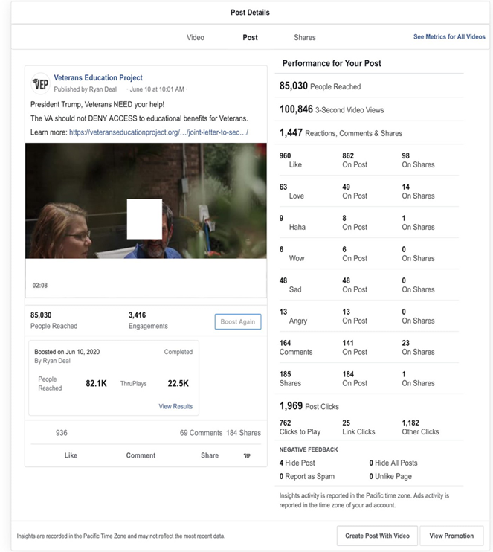
What We Do
Impact Content
13 Videos
596,055 views
16,00 engagements
Written 15 articles/op-eds
Produced 10 podcasts
Published over 50 Blogs
Our digital campaigns have reached and impacted policy makers at the highest level within the WH, VA, DOD and Congress.

Slide 44
The Problem
Partisan politics and have eroded bipartisan principles that protect Student Veterans.
Advocacy efforts from within career education have become ineffective and there are few allies from outside the sector.
VSOs in Washington, D.C. are not sector-agnostic or committed to nonpartisan policy and legislation in higher education.
Many VSOs have utilized media and advertisements to push a false narrative about Student Veterans who attend non-traditional institutions.

Slide 45
Our Solution
Influence Congress with balanced nonpartisan research
Ensure legislation and policy protect Veterans at all institutions across all sectors of higher education
Build a wide coalition within the VSO Community
Shift public opinion via digital and social media engagement

Slide 46
Research Opportunities
Release quarterly investigations, coordinated with media, to influence public opinion in the VSO community and Capitol Hill.
Legislative and cultural change end and begin with a report in-hand. Currently nonpartisan, evidence-based research is lacking.
90/10 Investigation to Get the Truth
Marketing Practices Across All Sectors of Higher Education
All-Sector’s Response to COVID-19: Distance Education

Slide 47
Media Strategy
Our opponents have the funding and willingness to run multiple marketing campaigns on a myriad of platforms.
To change the discussion surrounding Veteran’s education, we must engage in similar ad-campaign strategies.
Influencer campaigns
Produce impactful videos
Ad-buys across all platforms
Compelling digital content
Writing op-eds/articles

Slide 48
Questions?
Questions
Submit your questions via the GoToWebinar control panel
Don’t see the question box? Use the orange grab tab
arrow to expand
Post Webinar Housekeeping
Webinar recording will be emailed to attendees and available for download at: www.graggadv.com/webinars
Looking for certification? email: webinars@graggadv.com

Slide 49
Upcoming 2020 Webinars
November 20th – 7 Costly PPC Mistakes: Avoid money-sucking mishaps

Slide 50
Thank you.
Any questions?
Contact Gragg at webinars@graggadv.com
All information, strategy and messaging contained and included within this presentation is the sole and complete property of Gragg Advertising. Any execution or use of this information without the authorization or permission of Gragg Advertising is an infringement and violation of proprietary and confidential contained, arranged and owned in this presentation by Gragg Advertising.

